Slide 1
Recovery and improvement of athletes performance
Teacher:
Molchanov Vitaly
The Department of Sports disciplines of Gomel State University

Slide 2
The main purpose of the course is to introduce and teach students the basic, traditional and special methods and means of improving physical performance in sports

Slide 3
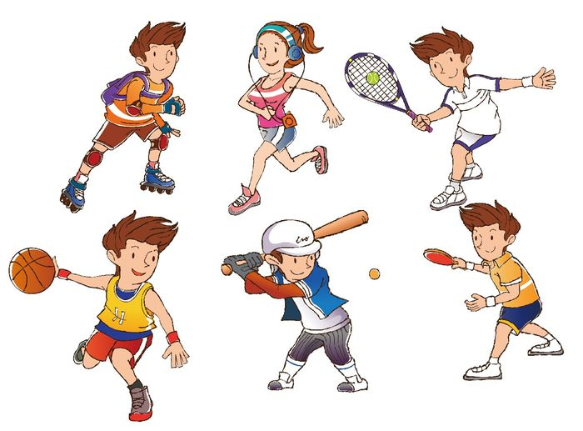
Common characteristic of modern sports

Slide 4
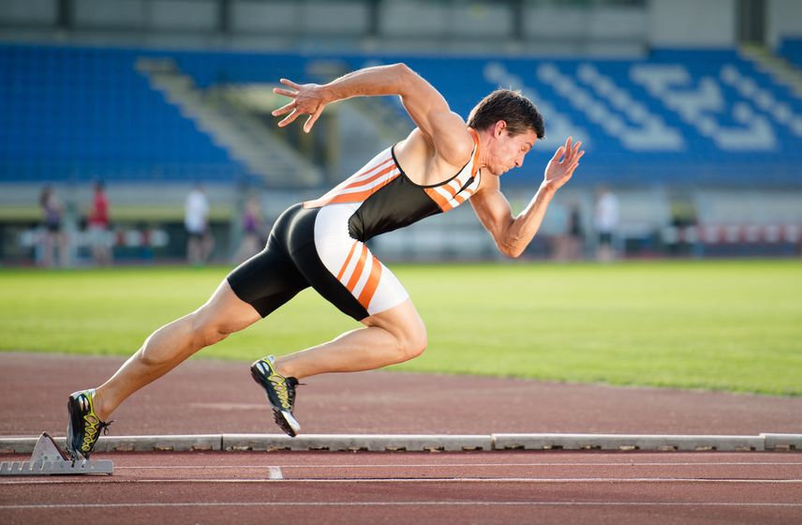
Sport is an integral part of physical culture, a means and method of physical education based on the use of competitive activities and preparation for it, in the process of which the potential abilities of a person are compared and evaluated.

Slide 5
Sport
Mass sports
Sports of the highest achievements

Slide 6
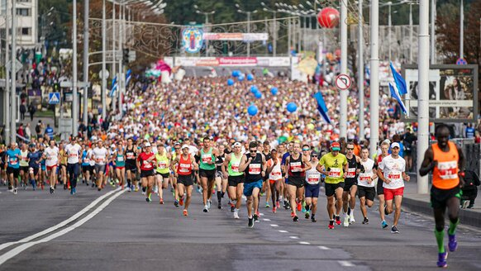
Minsk Half Marathon is an example of mass sports

Slide 7
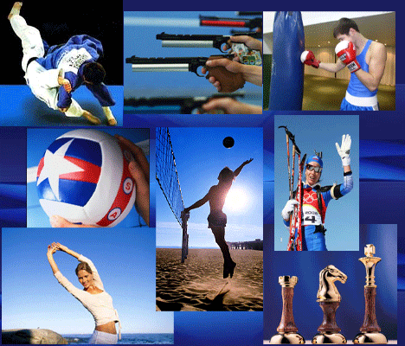
Sports of the highest achievements
The purpose of the professional sports is to achieve the highest possible sports results or victories at the largest sports competitions.

Slide 8
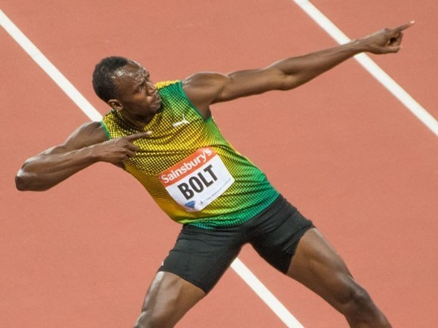
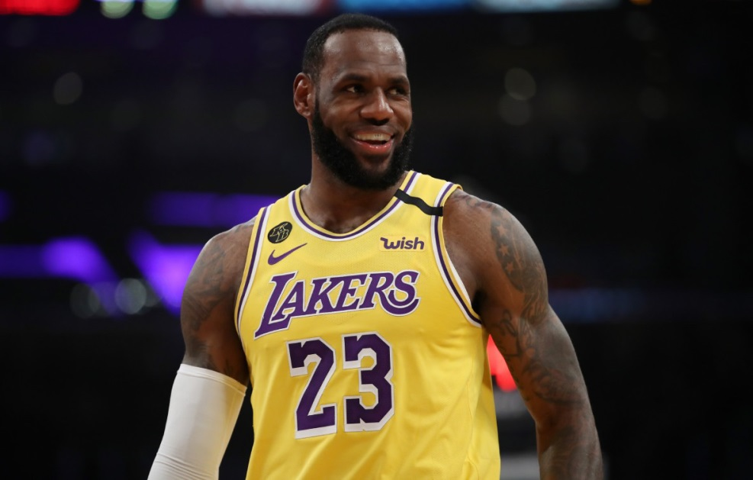
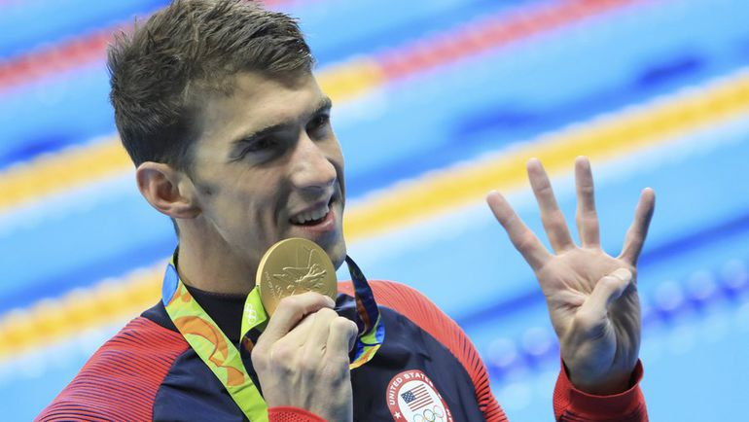
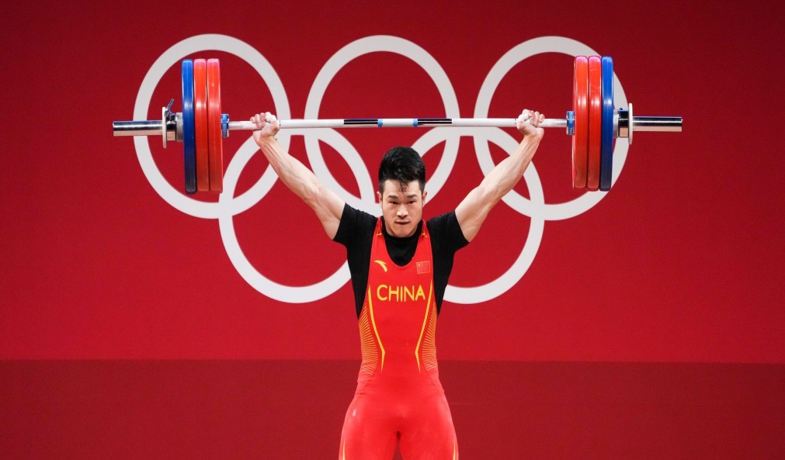
Sports of the highest achievements

Slide 9
Features of the current stage of the development of sports of highest achievements
Very high level of sports achievements and their continued growth
High tension of competitive struggle
Professionalization of sports
High level of commercialization of sports of highest achievements
The using of modern scientific technologies

Slide 10
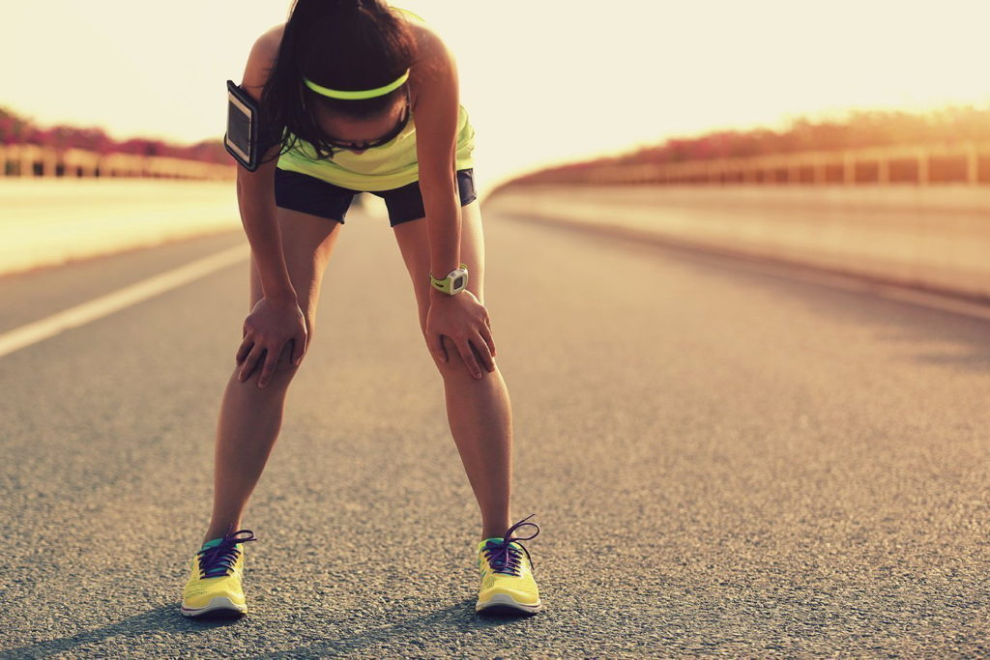
One of the most important problems in modern sports is to improve the performance of athletes.

Slide 11
Currently, the problem of improving the performance of athletes cannot be solved only by improving the means and methods of training, increasing the amount and intensity of training load. After all, their further increase can negatively affect the health and functional state of athletes and lead to overtraining and sports injuries.

Slide 12
An abrupt increase in the amount and intensity of training loads leads to
The overload of the musculoskeletal system
The morphofunctional changes in body tissues and organs
The emergence of injuries and diseases

Slide 13
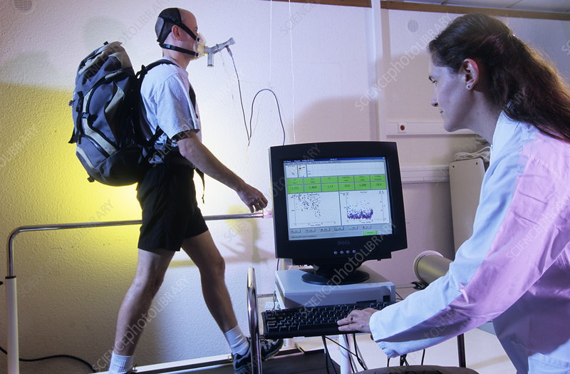
Physiological and biochemical research shows that recovery processes, depending on their orientation, can both ensure the growth of working capacity and lead to its decline.

Slide 14
If during the training the effects are constantly and significantly exceed the renewal, destructive changes develop, leading to cell death. There is a condition that physiologists describe as chronic exhaustion, and sports doctors – as overtraining.

Slide 15
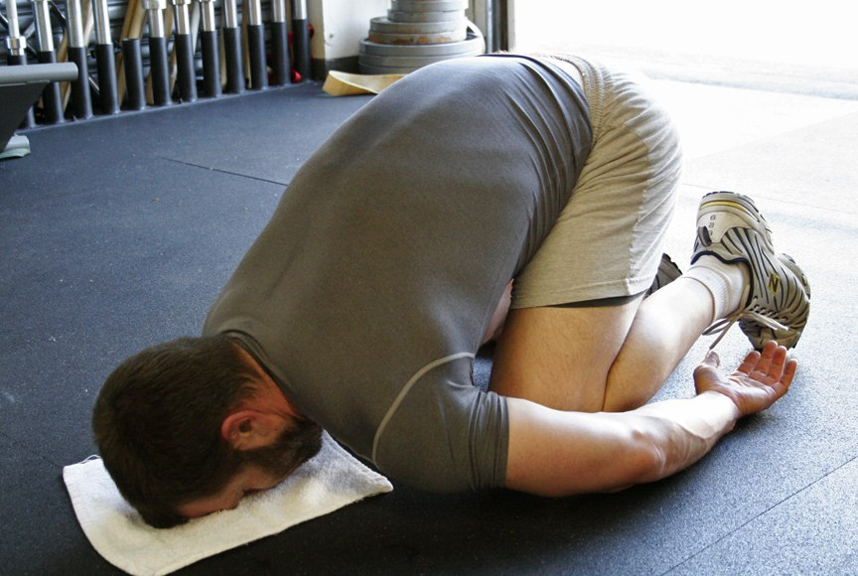
Overtraining

Slide 16
The consequences of overtraining
The maximum mobilization of all body functions
The destruction of microstructures
The disruption of the function of enzyme systems
The disruption of the mechanisms of intersystem regulation
The disruption of the balance of the internal environment

Slide 17
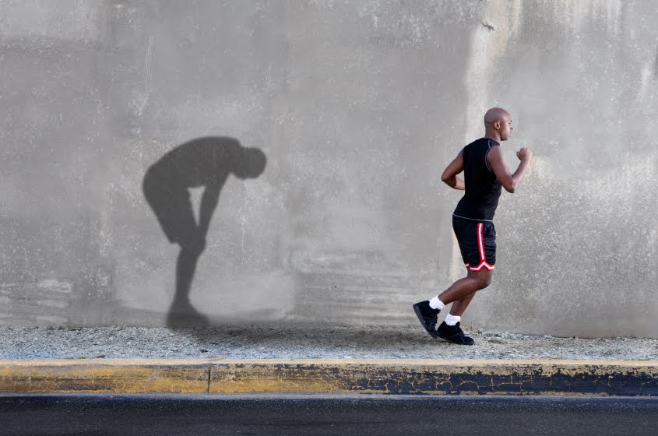
Modern science of sports has numerous data on the mechanisms of recovery processes, the features of their progress depending on the kind of sport and the athlete's preparedness

Slide 18
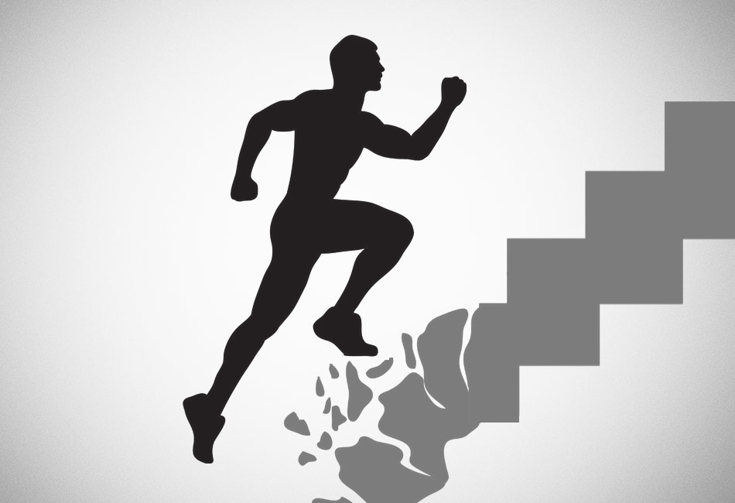
During the training should be monitored the process of adaptation of athletes to loads and their tolerance, and should be planned recovery measures based on the data received.

Slide 19
Recovery means are divided into three groups
Pedagogical means of recovery
Psychological means of recovery
Medico-biological means of recovery

Slide 20
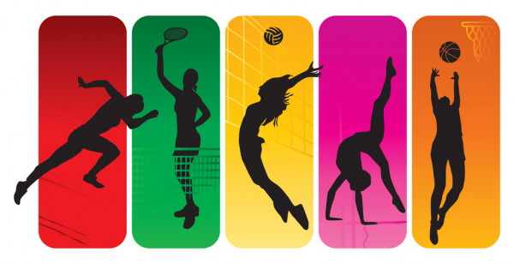
Rational and systematic use of recovery means determines the effectiveness of the entire system of training athletes of various qualifications

Slide 21
The End

